Slide 1


4th IEEE International Conference on
Sensors and Related Networks - Special Focus on Digital Healthcare
SENNET-2025
24th - 27th , July 2025 | Vellore Institute of Technology, Vellore, India
SENNET - 2025
Paper ID: 304
Indian sign language to voice using ESP32_Cam for hand tracking and MediaPipe for hand gesture detection
Authors and Affiliation:
Shubham Sony
Arjun Lande
Ankur Banerjee
Ajay Sharma
Shamneesh Sharma
Lovely Professional University, Upgrad Campus
Presented By:
Arjun Lande
Dept of Computer Science and Engineering

Slide 2
Agenda
Introduction
Literature Survey
Aim & Objectives
Proposed Methodology
Architecture / Design
Algorithm / Technique
Experimental Results
Discussions
Application / Use cases
Conclusion & Future Work
References

Slide 3
Introduction
Background
Over 63 million people in India suffer from hearing loss, making communication a significant challenge.
Indian Sign Language (ISL) is used by the deaf-mute community but is not widely understood by the general public.
Multiple regional sign language variants further complicate communication.
Motivation for work
Existing solutions mainly support ASL, not ISL.
Glove-based systems are expensive and non-portable.
Need a real-time, low-cost ISL recognition system.
Research problem statement
How can we build a low-cost, embedded real-time system to recognize ISL gestures and convert them to speech using computer vision?

Slide 4
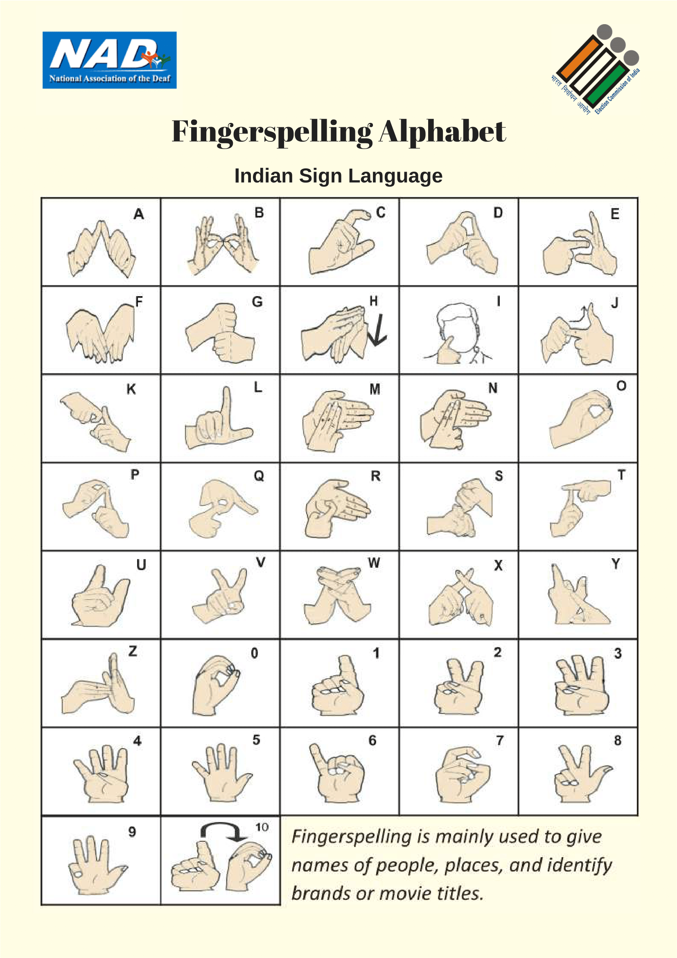
Introduction
In this study, we utilize Indian Sign Language (ISL) hand gestures that are officially approved by the Election Commission of India. These standardized gestures ensure consistency, authenticity, and relevance, particularly in the context of accessible communication for the hearing and speech impaired during the electoral process. By incorporating these approved gestures, our system aligns with nationally recognized sign language standards.
Fig.1. ISL Alphabets Approved by the Government of India (ECI)

Slide 5
Literature Survey
Key related works and findings
ASL-based systems using gloves, sensors, or Kinect.
CNN and LSTM models improving static and dynamic gesture recognition.
Gaps and limitations in existing work
Limited ISL-focused solutions.
High dependency on expensive hardware.
Lack of portability and real-time feedback.
Addressing those gaps
Uses ESP32-CAM (₹1200–₹1600) and MediaPipe.
Designed specifically for ISL.
Supports both gesture-to-text and text-to-speech in real-time.

Slide 6
Literature Survey
Author(s) & Year | Tools & Technology Explored | Key Topic Explored
Trilla & Alias (2013) | Text-to-Speech (TTS) systems, sentiment analysis, prosody control | Focused on improving the naturalness of synthesized speech by integrating sentence-level sentiment to modify speech prosody.
Crocioni et al. (2019) | GLOVE word embeddings, NLP, speech-to-text systems | Enhanced speech recognition by embedding semantic meaning from recognized speech using pre-trained word vectors (GLOVE).
Bush et al. (2019) | SVM, k-NN, Neural Networks for gesture recognition | Compared various machine learning models to analyze and improve hand gesture classification accuracy.
A. Chaudhary et al. (2016) | Improved Random Forest classifier, multi-class classification techniques | Proposed enhancements to the traditional Random Forest model to boost performance in multi-class agricultural datasets.

Slide 7
Literature Survey
Author(s) & Year | Tools & Technology Explored | Key Topic Explored
Sharma et al. (2021) | Machine learning algorithms, OpenCV, image processing tools. | Applied ML techniques to tackle real-world image processing problems like denoising, segmentation, and feature extraction.
Kwon & Kim (2022) | OpenCV, MediaPipe, pose detection | Developed a real-time posture correction system using computer vision for exercise monitoring and feedback.
Das & Halder (2024) | ESP32-CAM, real-time face detection and tracking | Designed an embedded system for continuous face recognition, useful in surveillance and smart monitoring environments.
J. Kunjumon & R. K. Megalingam (2019) | Hand gesture recognition, ISL translation, speech synthesis | Designed a system to translate Indian Sign Language into text and speech using computer vision and gesture recognition techniques.

Slide 8
Aim & Objectives
Aim
To develop a real-time ISL-to-voice communication system using embedded vision and machine learning.
Objectives
Capture hand gestures using ESP32-CAM.
Detect hand landmarks using MediaPipe.
Classify gestures using Random Forest.
Convert recognized text to speech (TTS).
Improve accessibility for deaf-mute individuals.

Slide 9
Proposed Methodology
Proposed approach/system/model
External USB camera used for both gesture recognition and hand tracking.
MediaPipe processes video stream to detect hand landmarks.
Recognized gestures classified using Random Forest model.
Text output converted to speech using Google TTS
Datasets
Custom primary dataset collected at LPU campus from 16 individuals performing Indian Sign Language (ISL) gestures.
Each gesture sample includes (x, y) hand landmark coordinates captured using MediaPipe.
The dataset covers alphabets and number ISL gestures.
Tools, frameworks used
MediaPipe
ESP32-CAM
Python + OpenCV
scikit-learn
Google Text-to-Speech (gTTS)

Slide 10
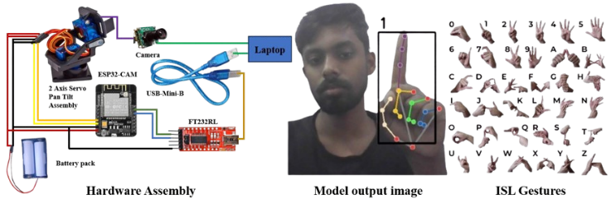
Hardware and Assembly Diagram
Fig. 2. Hardware assembly and model output

Slide 11
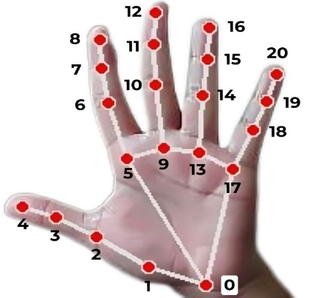
Hardware and Assembly Diagram
0 | WRIST | 11 | MIDDLE_FINGER_DIP
1 | THUMB_CMC | 12 | MIDDLE_FINGER_TIP
2 | THUMB_MCP | 13 | RING_FINGER_MCP
3 | THUMB_IP | 14 | RING_FINGER_PIP
4 | THUMB_TIP | 15 | RING_FINGER_DIP
5 | INDEX_FINGER_MCP | 16 | RING_FINGER_TIP
6 | INDEX_FINGER_PIP | 17 | PINKY_MCP
7 | INDEX_FINGER_DIP | 18 | PINKY_PIP
8 | INDEX_FINGER_TIP | 19 | PINKY_DIP
9 | MIDDLE_FINGER_MCP | 20 | PINKY_TIP
10 | MIDDLE_FINGER_PIP
Fig. 3. Media pipe Landmarks Representation for hand-held gesture controls
Table. 1. Showing the landmark representation of palm, hand, finger tips, and palmar flexion creases

Slide 12
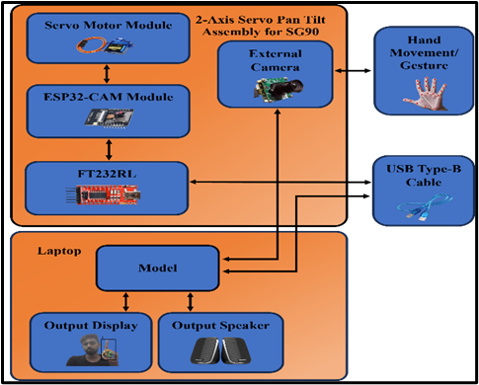
Architecture / Design
System architecture diagram
Fig. 4. System Architecture Design data flow diagram for the Hand Tracking for Sign Language

Slide 13
Architecture / Design
Explanation of each module/component
External camera captures video stream.
ESP32-CAM controls servo motor to align view.
MediaPipe detects, segments hand landmarks and helps in tracking hand movement.
Random Forest Classifier predicts ISL gesture.
Text converted to speech using TTS.

Slide 14
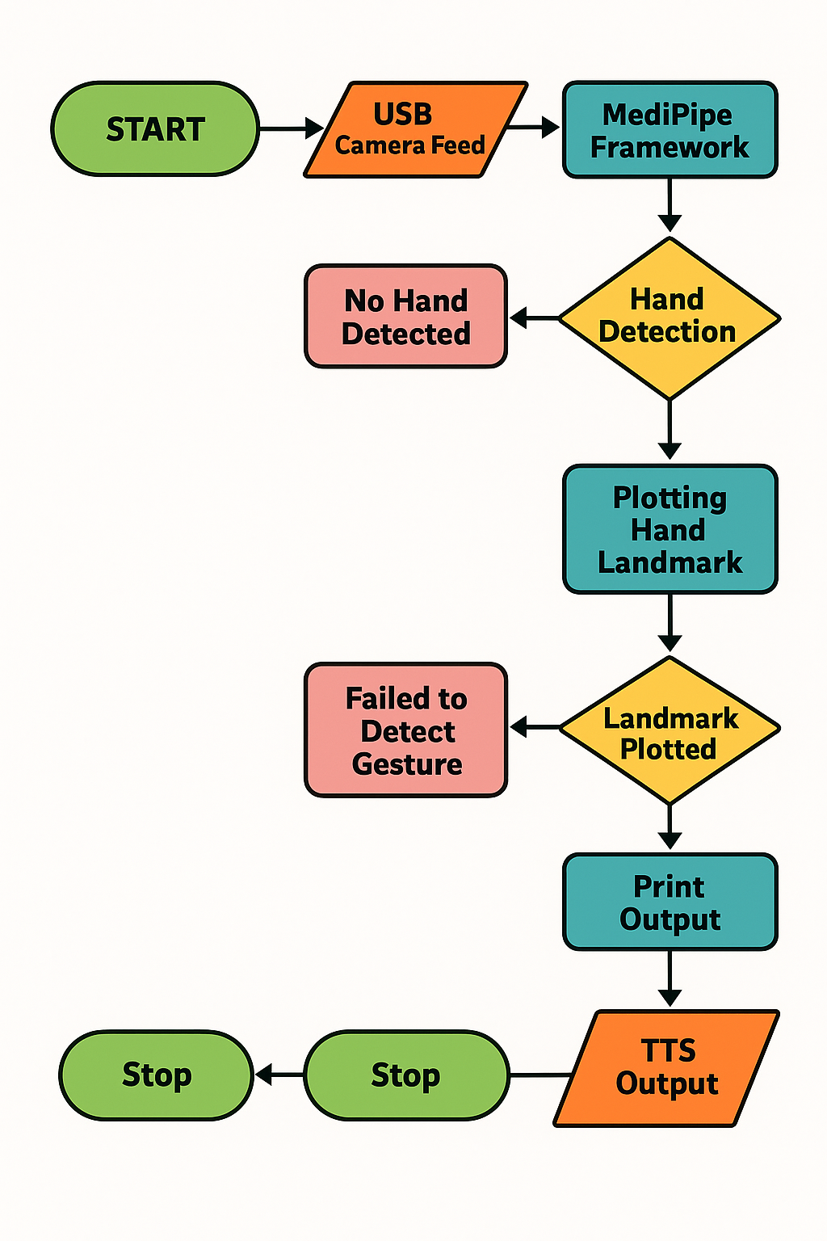
Algorithm / Technique Used
Why Random Forest?
Handles high-dimensional input well
Robust to overfitting
Fast and easy to tune for small to medium datasets
Fig. 5. Dataflow Diagram

Slide 15
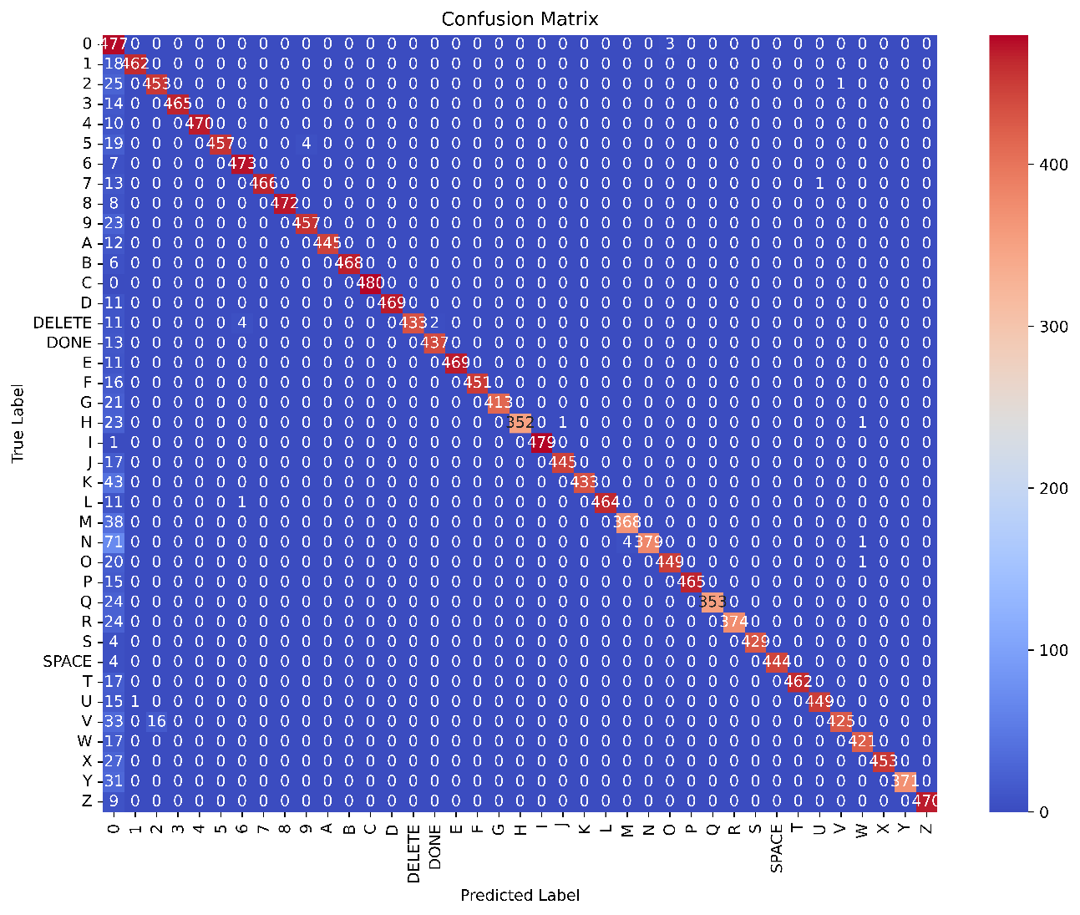
Experimental Results
Fig. 6. Confusion Matrix showing the result of correlation between the predicted label class and actual label class

Slide 16
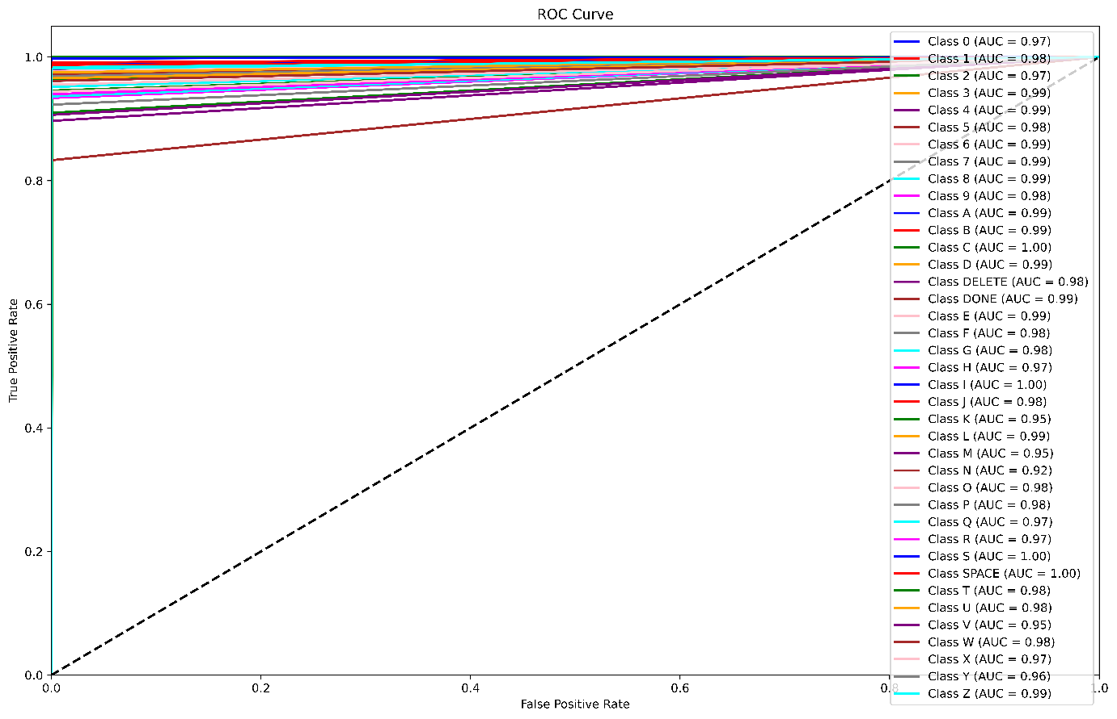
Experimental Results
Metrics used
Accuracy: 95.67%
Precision: 0.98
Recall: 0.96
F1-Score: 0.97
Fig. 7. Receivers Operator Curve showing the value for each class

Slide 17
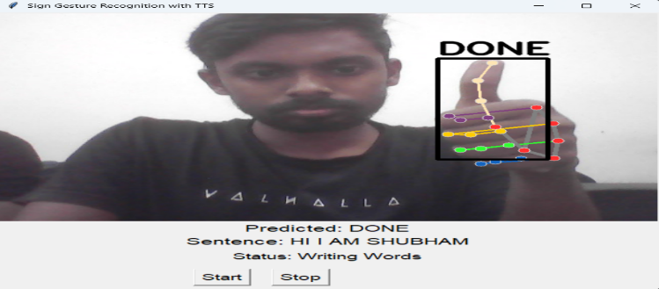
Experimental Results
Fig. 8. GUI Interface showing the predicted word along with the voice narration for sign language.

Slide 18
Discussions
Interpretation of results
System accurately detects ISL gestures in real-time
Delivers speech output with minimal delay
Strengths
Cost-effective and portable
No wearable devices required
Real-time gesture-to-voice conversion
Limitations
Lighting dependency for ESP32-CAM
Accuracy drops with occlusions or background clutter

Slide 19
Applications / Use Cases
Real-world relevance of your work
Helps deaf-mute individuals communicate with hearing people
Specific industries or problems your work can address
Education
Can be used in special education environments
Healthcare
Enables better patient-provider interaction in hospitals
Public Services
Can be used at help desks, banks, or government offices for inclusive access

Slide 20
Conclusion & Future Work
Summary of contributions
Achieved real-time ISL recognition with 95.67% accuracy
Portable, low-cost system using ESP32-CAM + MediaPipe
Bridges communication gap without wearable hardware
Answer for the research question
We developed a low-cost, real-time system using MediaPipe, ESP32-CAM, and machine learning to recognize Indian Sign Language (ISL) gestures. The recognized gestures are converted to speech using Google TTS, enabling seamless communication. The system is efficient, hardware-flexible, and achieves 95.67% accuracy, making it a practical solution for assistive communication.
Ideas for further research
Add support for dynamic ISL words and phrases
Include regional Indian language voice outputs
Optimize for mobile deployment or cloud integration

Slide 21
References
[1] National Program for the Prevention & Control of Deafness (NPPCD) :: National Health Mission’. Accessed: Apr. 08, 2025.
[2] S. Kumar, K. Sharma, G. Raj, D. Datta, and A. Ghosh, ‘Arduino and ESP32-CAM-Based Automatic Touchless Attendance System’, Lecture Notes in Electrical Engineering, vol. 851, pp. 135–144, 2022, doi: 10.1007/978-981-16-9154-6_14.
[3] Suraksha Devi and Suman Deb, Low-cost tangible glove for translating sign gestures to speech and text in Hindi language. IEEE, 2017.
[4] Geetha M and Harikrishnan R, ‘A Vision Based Dynamic Gesture Recognition of Indian Sign Language on Kinect based Depth Images’.
[5] Crocioni Giulia, Di Vece Chiara, and Hananeh Esmailbeigi, Glove for Speech Recognition. IEEE, 2019.

Slide 22
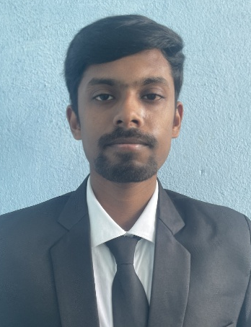
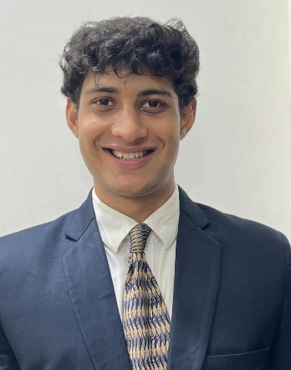
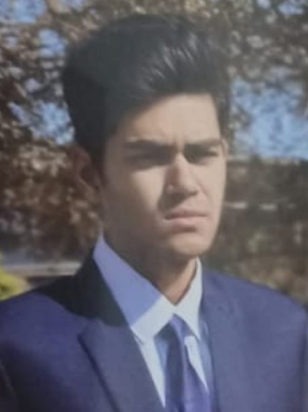
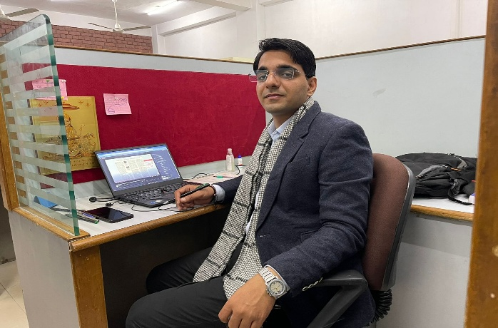
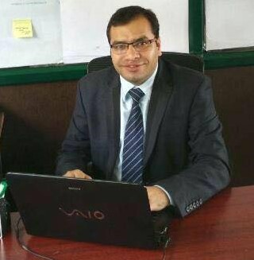
Meet our Team Members
Shubham Sony
Student at
Lovely Professional University
Arjun Lande
Student at
Lovely Professional University
Ankur Banerjee
Student at
Lovely Professional University
Ajay Sharma
Senior Technical Mentor: UpGrad Campus,
AI/ML at Lovely Professional University
Shamneesh Sharma
Head of the Department: UpGrad Campus, Lovely Professional University

Slide 23
…QA…
…Thank you…

